Slide 1
Classes & Design Patterns
Game 253

Slide 2
Introduction
Observer
Factory Method
Composite
Model-View-Controller
Spatial Index
Flyweight
Builder
Prototype

Slide 3
Observer
Objects know when the state of another object changes

Slide 4
Observer
Observed
  - Maintain a list of all observers, allow them to be added and removed
  - Notify the observers every time the state changes
Observer
  - Implements a callback method that gets called whenever the observed object’s state changes

Slide 5
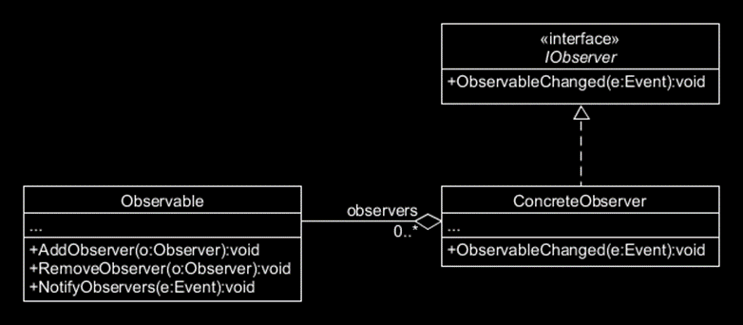
Observer
A simple implementation of the observer pattern.

Slide 6
Factory Method
Provides a method to create instances of a class while delegating the decision as to what subclass to instantiate to another class

Slide 7
Factory Method
The factory method decouples instantiation code from implementation code.
Allows for adding new types of components.

Slide 8
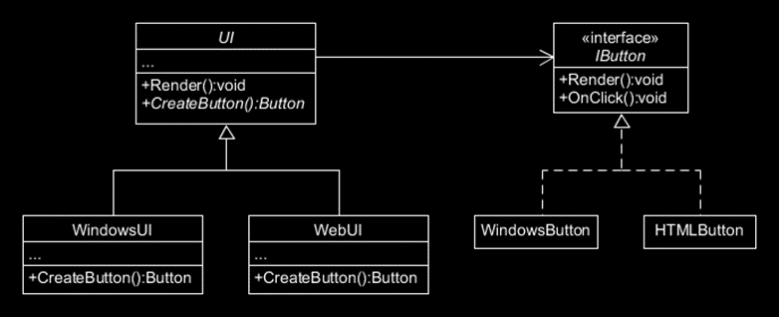
Factory Method
A simple implementation of the factory method pattern for cross platform UI.

Slide 9
Composite
An object is composed of several sub-objects that all need to behave as a single object

Slide 10
Composite
Objects which can carry other objects just like themselves.
Additionally operations done on the “object” occur on all sub-objects
  - Think resizing a window, and all sub-objects (the stuff inside the window) resizes too

Slide 11
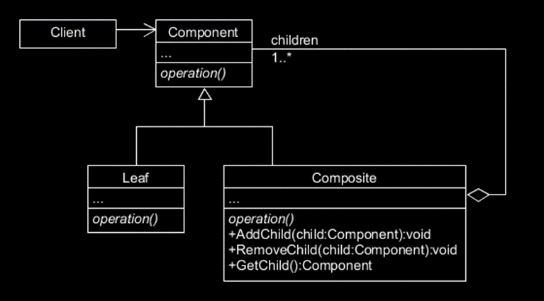
Composite
A simple implementation of the composite pattern for creating a tree structured composite where all objects support Operation().

Slide 12
Model View Controller
Splits data, rendering, and logic into separate parts which can be interchanged.

Slide 13
Model View Controller
Models hold the data
Views render the game on screen
Controllers perform game logic

Slide 14
Model View Controller
Interfaces are used to communicate between parts
You should be able to modify a part without changing its interface
You should be able to replace one part with a new part and not require any change to the code in other parts

Slide 15
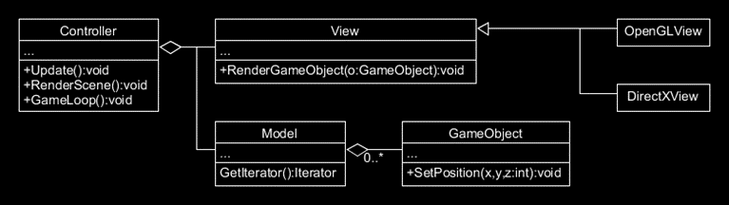
Model View Controller
A simple implementation of the model-view-controller that has both OpenGL and DirectX

Slide 16
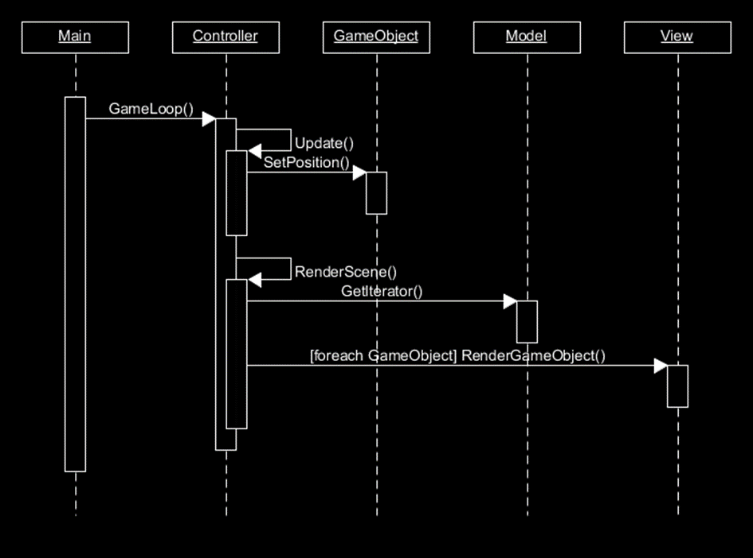
Model View Controller
The controller is the game engine
The model is the collection of objects in the scene
The view is the graphics system rendering the scene

Slide 17
Spatial Index
A spatially dependent index that provides rapid access to the objects in game based on their location

Slide 18
Spatial Index
Often necessary to find an object at a location as rapidly as possible
Spatial indexing solves this problem by splitting space in the game into smaller and smaller spaces
Each space has a list of all objects inside that space
These spaces are structured as a tree, so that large portions of the tree can be eliminated depending on the depth

Slide 19
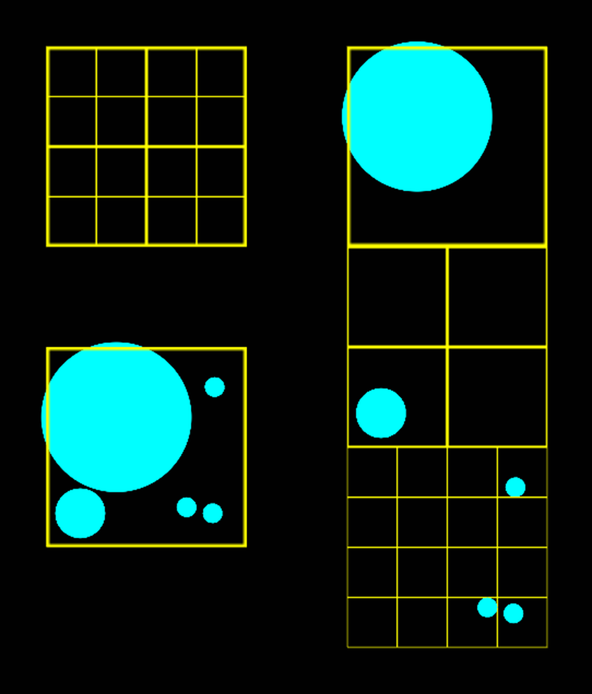
Spatial Index – Quad Tree
Sorts objects into the smallest boxes they can fit in
Can easily get a list of objects at any given position.
Starting with the bottom right image we can put each of those shapes into one of the boxes, depending on whether the box is larger than them, seen on the right.

Slide 20
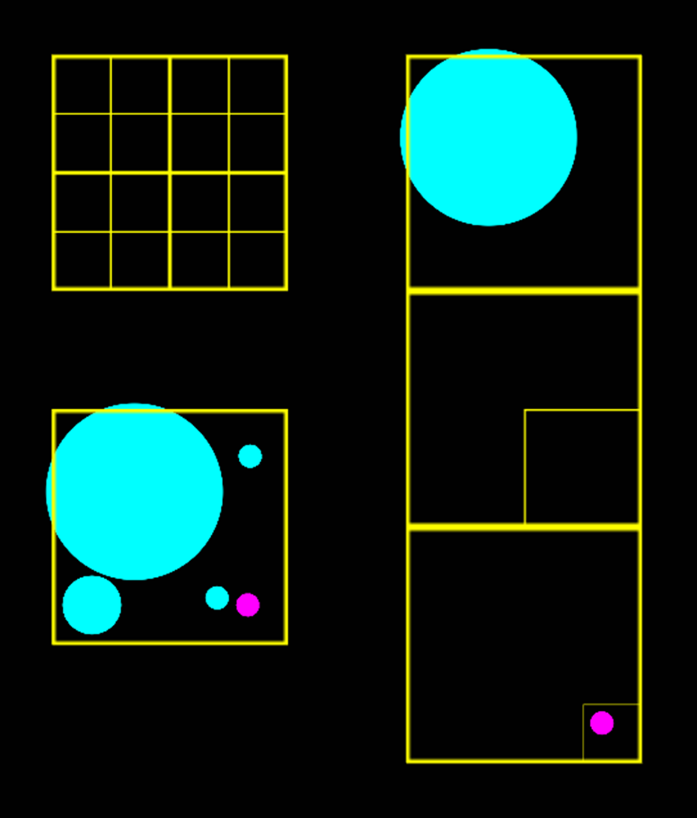
Spatial Index – Quad Tree
In a physics update, we want to determine if there are any collisions to resolve for the magenta object
All we need to do is look up all the lists of objects in each node of the tree that the object or its tree node is a child of
We have reduced the physics tests for this object from 4 tests to 1 (Magenta ball checks against the biggest ball)

Slide 21
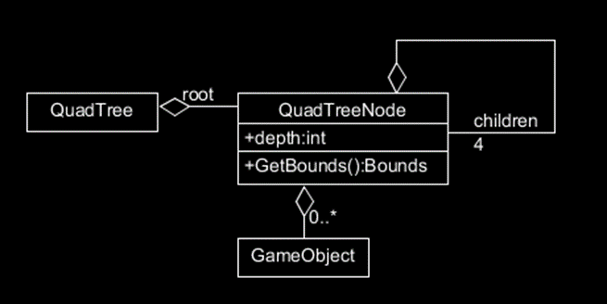
Spatial Index
A simple implementation of the spatial index pattern, as a quad tree

Slide 22
Flyweight
Maintains a large number of small objects with different properties without consuming large amounts of memory

Slide 23
Flyweight
Separate attributes that do not vary into a referenced object that exists in one place in memory
Store only the instance based attributes with the flyweight instance, in that way it is smaller in memory, and less expensive to construct and destroy

Slide 24
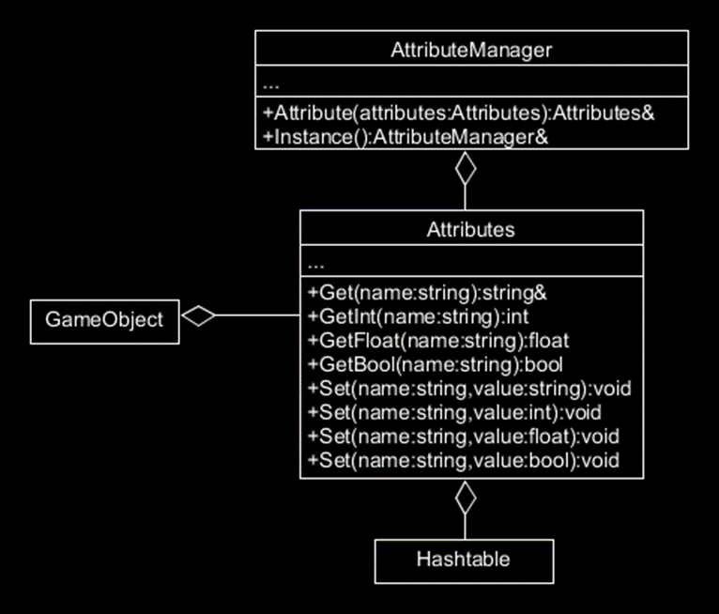
Flyweight
A simple implementation of the flyweight pattern that can share common attribute groups between objects

Slide 25
Builder
Separates the representation of an object from the construction of the object

Slide 26
Builder
Consider we have an Image in game, but externally we have .bmp, .jpg, .png, etc…
The builder pattern separates our Image from the specific way we need to load each image type

Slide 27
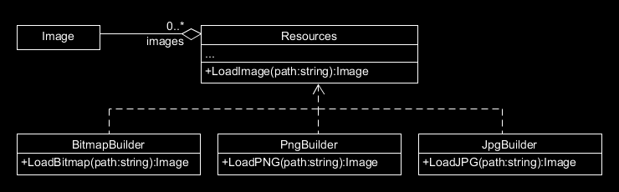
Builder
A simple implementation of the builder pattern that handles loading an image from either png, bmp, or jpg

Slide 28
Prototype
Save common configurations of objects for rapid instantiation

Slide 29
Prototype
Common configurations of complex objects are saved for cloning
By copying their attributes we avoid having to set up each object individually

Slide 30
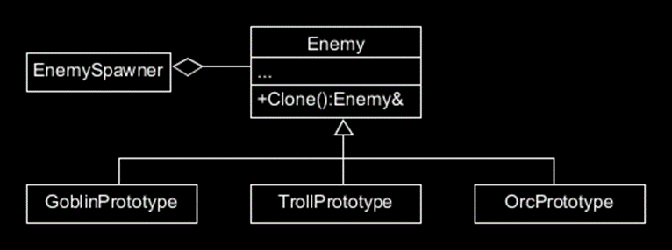
Prototype
A simple implementation of the prototype pattern that implements a clone method

Slide 31
Have a great week!
Keep safe out there.

